Slide 1
Virtual Doctor
A chatbot for helping the healthcare providers by identifying and rectifying the loopholes in the value chain of booking an appointment to getting cured with the help of a personalized Virtual Doctor that would help hospitals in reducing the hassles of handling patients. By deploying this chatbot the hospitals, as well as other stakeholders, can immensely benefit through a positive behavioral change

Slide 2
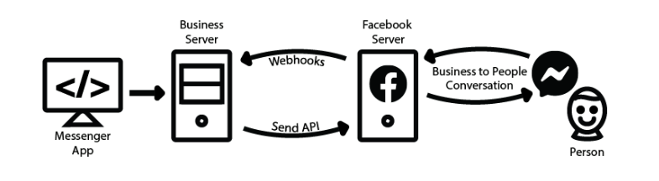
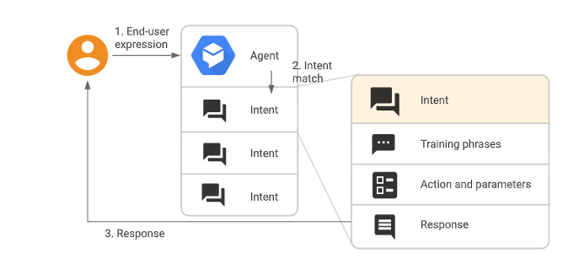
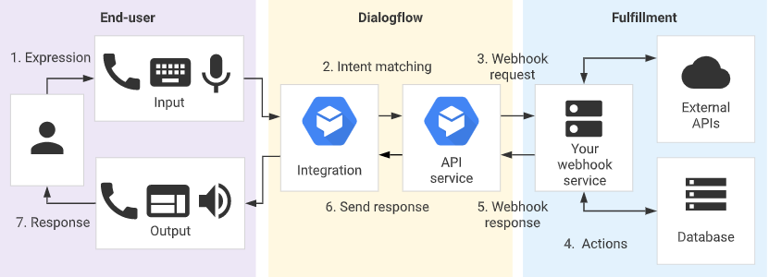
Project Architecture-Design

Slide 3
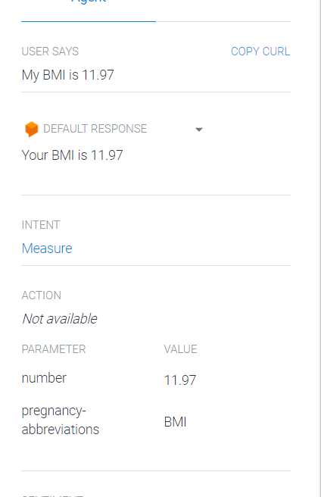
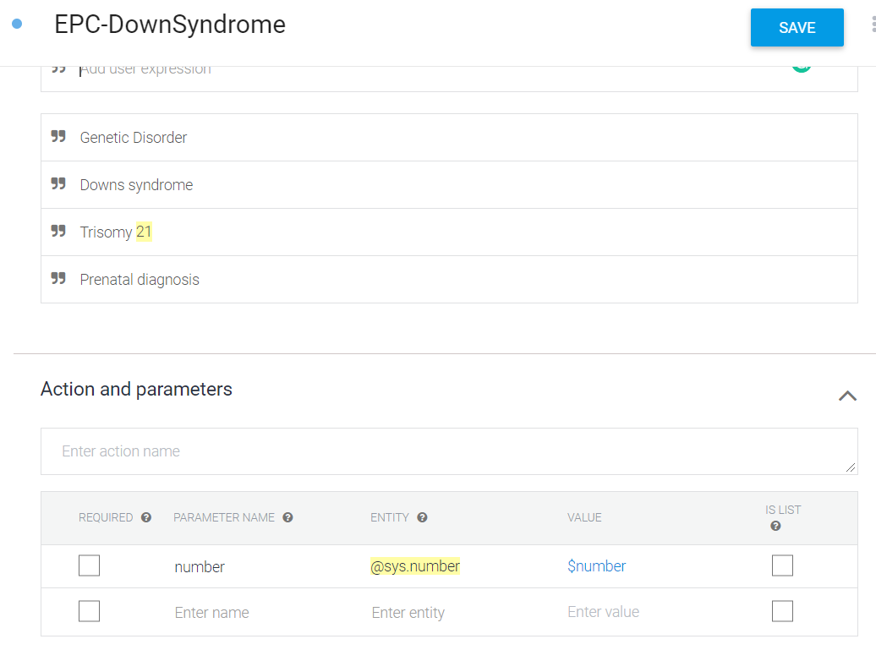
On encountering these expressions we classify them into the above specified intent.
The number value gets extracted as a parameter

Slide 4
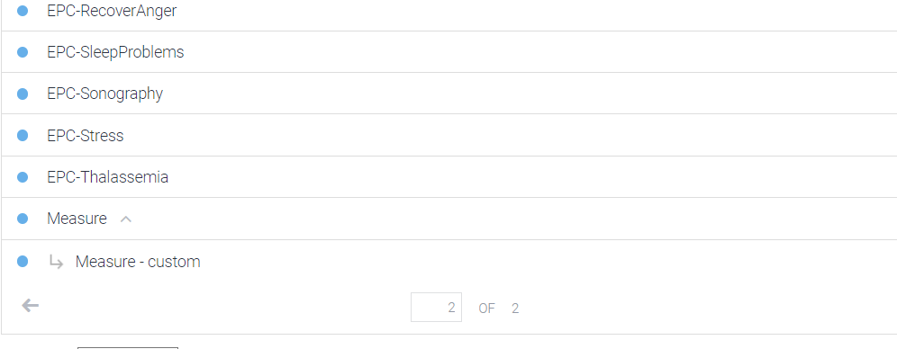
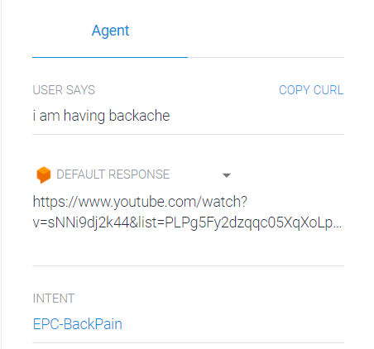
Different Intent Categories
Intent Classification and Response
The Chatbot groups the message into the specific intent and suggests the appropriate video from YouTube or the appropriate article from the internet. The information shared is approved by the doctors.

Slide 5
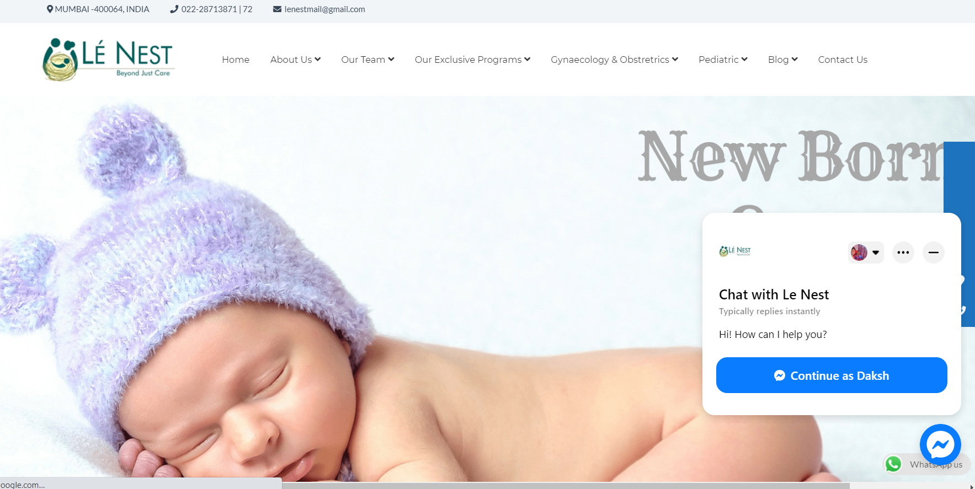
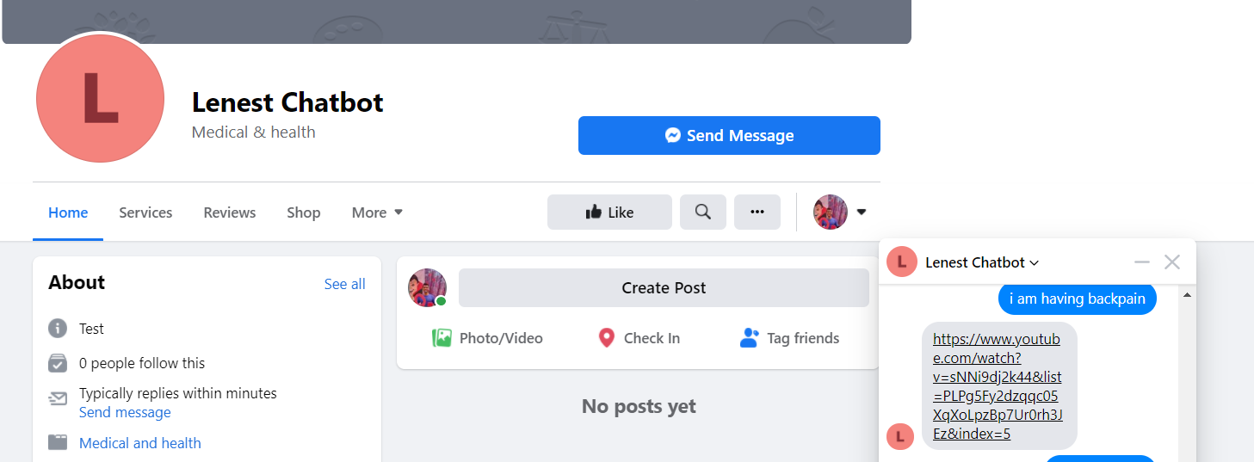
Chatbot deployed on Facebook and Website

